Slide 1
Amazon Rekognition
Automate your image and video analysis with machine learning
Péter Molnár, AWS Professional Services

Slide 2
Our mission at AWS
Put machine learning in the hands of every developer
Notes:
Our mission is to take our rich experience and expertise with machine learning across Amazon and put it in the hands of all organizations--every developer, data scientist, reseacher.
Said another way, we want to simplify machine learning. We want to make it easy for all developers to easily build intelligent applications

Slide 3
Why AWS for ML?
BROADEST AND DEEPEST SET OF AI AND ML SERVICES
ACCELERATE YOUR ADOPTION OF ML
BUILT ON THE MOST COMPREHENSIVE CLOUD PLATFORM
250 new features and services launched this last year for everyone from ML scientists to application developers
Amazon SageMaker creates efficiencies and lowers costs
Acceleration programs and trainings
The strongest set of compute, storage, security, database, and analytics capabilities to build upon
Notes:
To sum up, there are three core reasons why we think AWS is the right partner for your machine learning journey.
First, we provide the broadest and deepest set machine learning and AI services for your business:
AWS is unmatched in the breadth and depth of capability we offer to customers.
We launched over 250 new features and services in the last year
And our pace is only accelerating; developers will love waking up virtually every day with new capabilities at their finger-tips.
Second, we can accelerate the adoption of machine learning:
Amazon SageMaker makes it much easier for everyday developers and scientists to embrace machine learning.
Before SageMaker, doing ML was just too hard for most customers. By making ML easier, at low cost, customers can make better use of their data – which is both valuable and differentiating.
Models that previously took customers months and extensive specialized expertize can now be built in weeks or even days.
AWS has also invested in acceleration programs including the ML Solutions Lab and education and training programs like AWS DeepRacer and AWS ML Embark to help your organization more readily adopt ML.
Third, you get the confidence of building on AWS, the most comprehensive cloud platform optimized for machine learning:
That’s why today If you look at the amount of TensorFlow that runs in the cloud, 85 percent of the TensorFlow in the cloud runs on AWS.
We have a team that does nothing but work on optimizing TensorFlow performance on AWS. And they have done a lot of innovation.
Finally, you need the right highly secure, highly reliable, fully featured data store with the right access control, the right security, the broadest set of analytics, and really robust offerings -- at all three layers of the machine learning stack, which we believe that most companies with modern technology capabilities in the future will clearly operate at all three layers of that stack. That's what machine learning is and what's needed, and nobody has that set of capabilities collectively like AWS, which is why twice as many companies are using AWS for machine learning as anybody else.
Supporting data point:
Amazon EC2 Inf1 instances are built from the ground up to support machine learning inference applications. Inf1 instances feature up to 16 AWS Inferentia chips, high-performance machine learning inference chips designed and built by AWS. In addition, we’ve coupled the Inferentia chips with the latest custom 2nd generation Intel® Xeon® Scalable processors and up to 100 Gbps networking to enable high throughput inference. This powerful configuration enables Inf1 instances to deliver up to 3x higher throughput and up to 40% lower cost per inference than Amazon EC2 G4 instances, which were already the lowest cost instance for machine learning inference available in the cloud. Using Inf1 instances, customers can run large scale machine learning inference applications like image recognition, speech recognition, natural language processing, personalization, and fraud detection, at the lowest cost in the cloud.

Slide 4
Machine learning on AWS is happening in companies of every size and industry
Tens of thousands customers have chosen AWS for their ML workloads | More than twice as many customers using ML than any other cloud provider
Notes:
This approach resonates with our customers
More ML happens on AWS than anywhere else. From the largest enterprise through to the hottest startups, AWS has over twice the number of machine learning based public references than any other provider.
Companies are working with us to build solutions that are core to their business.

Slide 5





The AWS ML Stack Broadest and most complete set of machine learning capabilities
AI SERVICES
 | VISION | SPEECH | TEXT | SEARCH | CHATBOTS | PERSONALIZATION | FORECASTING | FRAUD | DEVELOPMENT | CONTACT CENTERS
Amazon Rekognition
Amazon Polly
Amazon Transcribe
+Medical
Amazon Comprehend
+Medical
Amazon Translate
Amazon Textract
Amazon Kendra
Amazon Lex
Amazon Personalize
Amazon Forecast
Amazon Fraud Detector
Amazon CodeGuru
Contact Lens
For Amazon Connect
ML SERVICES
Ground Truth | AWS Marketplace for ML |  |  |  |  |  |  |  |  |  | Neo | Augmented AI
 |  | Built-in algorithms | Notebooks | Experiments | Processing | Model training and tuning | Debugger | Autopilot | Model hosting | Model Monitor
SageMaker Studio IDE
Amazon SageMaker
ML FRAMEWORKS & INFRASTRUCTURE
Deep Learning AMIs & Containers | GPUs & CPUs | Elastic Inference | Inferentia | FPGA
DeepGraphLibrary
Notes:
We’re innovating on behalf of our customers to deliver the broadest and deepest set of machine learning capabilities for builders of all levels of expertise. At each layer of the stack, we’re investing in removing the undifferentiated heavy lifting so your teams can move faster.
Let’s take a walk through this the three layers.

Slide 6
The AWS ML Stack Broadest and most complete set of machine learning capabilities
AI SERVICES
 | VISION | SPEECH | TEXT | SEARCH | CHATBOTS | PERSONALIZATION | FORECASTING | FRAUD | DEVELOPMENT | CONTACT CENTERS
Amazon Rekognition
Amazon Polly
Amazon Transcribe
+Medical
Amazon Comprehend
+Medical
Amazon Translate
Amazon Textract
Amazon Kendra
Amazon Lex
Amazon Personalize
Amazon Forecast
Amazon Fraud Detector
Amazon CodeGuru
Contact Lens
For Amazon Connect
ML SERVICES
Ground Truth | AWS Marketplace for ML |  |  |  |  |  |  |  |  |  | Neo | Augmented AI
 |  | Built-in algorithms | Notebooks | Experiments | Processing | Model training and tuning | Debugger | Autopilot | Model hosting | Model Monitor
SageMaker Studio IDE
Amazon SageMaker
ML FRAMEWORKS & INFRASTRUCTURE
Deep Learning AMIs & Containers | GPUs & CPUs | Elastic Inference | Inferentia | FPGA
DeepGraphLibrary
Notes:
Now, at the top of the stack, we serve developers and companies who want to add solution-oriented intelligence to their applications through an API call rather than developing and training their own models in SageMaker. And we have a lot of services in this area to address your needs.
Vision (Rek Image and video) “tell me what’s in this image,” “which celebrities are in this image,” and, “is this image safe for work?”
Speech – (Polly, Transcribe) – If you want to turn text into speech we have Polly, and if you want to transcribe audio we have Transcribe
Text (translate, comprehend, textract) – If you want to translate text to different languages we have translate, and if you want to understand what’s being said in those translated corpuses of text you have Comprehend, if you want to extract text from documents using OCR++, you have Textract.
Then you have the things which Amazon is relatively famous for. Alexa and chatbots with Lex, personalization, and forecasting
Customers have asked us to continue to consider adding services around areas where we have a lot of experience and data from our consumer business…
Amazon Fraud Detector, a new fraud management service for detecting online identify and payment fraud in real-time. No machine learning experience required.
Amazon CodeGuru, a new machine learning service to automate code reviews and identify your most expensive line of code.
Contact Lens for Amazon Connect provides machine learning powered contact center analytics for Amazon Connect
Kendra, a new service which reinvents enterprise search with machine learning.
Let’s talk through some examples

Slide 7
Amazon Rekognition Overview

Slide 8


Amazon Rekognition Deep-Learning-Based Image and Video Analysis
Notes:
Amazon Rekognition is a service that applies machine learning to extract information from images and video

Slide 9




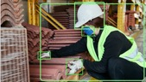


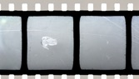

Amazon Rekognition Features
updated
updated
OBJECT, SCENE, AND ACTIVITY
CUSTOM LABELS
CONTENT MODERATION
TEXT
new
PPE DETECTION
FACE DETECTION AND ANALYSIS
FACE COMPARE & SEARCH
CELEBRITY RECOGNITION
new
VIDEO SEGMENTS
LIVE STREAM VIDEO
PATHING

Slide 10




Common applications of Amazon Rekognition
Automated image and video analysis at scale
WORKPLACE SAFETY
PPE detection
Vehicle or person detection
Person of interest
IDENTITY VERIFICATION
Test taker fraud detection
Know your customer (KYC)
Service access verification
MEDIA ANALYSIS
Search & discovery tagging
Content operations
Inappropriate content
INDUSTRIAL & RETAIL
Parts classification
Inventory management
Damage detection

Slide 11


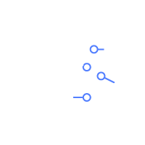
Why Amazon Rekognition
Build faster
Ready to integrate SDKs & APIs
High quality results
No ML Expertise required
Simplify operations
No ML models to build or manage
No data teams required
Get continuous improvements
Customize easily
Amazon Rekognition Custom Labels
Detect business-specific labels
Run trained models in your account
Innovate at the speed your business needs

Slide 12



































Amazon Rekognition Customers

Slide 13
Use cases and features

Slide 14




Media discovery
Live events
Media libraries
Social media
Influencer marketing

Slide 15



Tools for media discovery
Who
Celebrities
What
Labels and Activities
Where
Scenes and Text

Slide 16
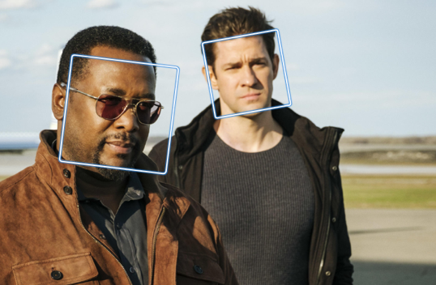
Celebrity detection
Amazon Rekognition quickly identifies well-known people in your video and images
Continually updated set of public celebrities who can be recognized
Jon Krasinski 99%
Wendell Pierce 97%

Slide 17




Video Segmentation
Video Segmentation – DETECT Black frames, color bars, end-credits, and shot changes
Black frames
End credits
Color bars
Shot Changes
Big Buck Bunny (2008) & Tears Of Steel (2013)
Blender Institute, shared under CC 3.0

Slide 18

Object and scene detection
Architecture 79.8%
Person 98.3%
Sports 94.3%
Amazon Rekognition automatically labels objects, concepts, and scenes in your images and provides a confidence score
Transportation 98.8%
Automobile 98.8%
Downtown 88.9%
Skateboard 94.3%
City 88.9%
Parking 86.2%
Road 92.4%
Asphalt 85.4%

Slide 19

Object and scene detection
Bounding boxes specify the location of common objects such as dogs, people and cars
You can use bounding boxes to infer how many of each object (”3 cars”), and the relationship between objects (“person on a skateboard”)

Slide 20
Content Moderation
Top-level category | Second-level category
Explicit Nudity | Nudity Graphic Male Nudity Graphic Female Nudity Sexual Activity Illustrated Nudity Adult Toys
Suggestive | Female Swimwear Or Underwear Male Swimwear Or Underwear Partial Nudity Revealing Clothes
Violence | Graphic Violence Or Gore Physical Violence Weapon Violence Weapons Self Injury
Visually Disturbing | Emaciated Bodies Corpses Hanging
Top-level category | Second-level category
Rude Gestures | Middle Finger
Drugs | Drug Products Drug Use Pills Drug Paraphernalia
Tobacco | Tobacco Products Smoking
Alcohol | Alcoholic Beverages Drinking
Gambling | Gambling
Hate Symbols | Nazi Party White Supremacy Extremist
Amazon Rekognition does not flag content as “safe” or “unsafe”
Instead, you get granular output about the nature of the content. You can apply your own policies that define what is safe for your customers.
Notes:
With Rekognition content moderation, you can:
* define your own content standards with granular output
* reduce time between when content is uploaded and content is published
* augment your moderation workflow, not necessarily replace it outright

Slide 21
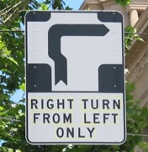
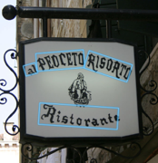

Text in the wild
Extract text content from real-world images in various layouts, fonts, and styles
New! Expanded support for text rotated -90 to +90 degrees from the horizontal axis

Slide 22


Face – Common Use Cases
Recognize Your Customer
Verify the identities of customers who opt-in
Customer Analysis
Analyze trends, not individuals

Slide 23





Recognize your customer Verify the identities of customers who opt-in
Similarity 93%
Similarity 0%

Slide 24


Face – customer analysis With trends, not individually
Sunglasses 99.5%
Glasses 89.6%
Amazon Rekognition object, scene, and activity detection can help you find customers’ social media posts about your product
Driving 95.4%
Accessories 99.5%

Slide 25
Face – customer analysis With trends, not individually
Female 99.9%
26–43 years old
Smiling 99.2%
Male 99.9%
Age 49–69 years old
Learn more about the customers who are using your products: Demographics, emotions, style, facial pose and landmarks
Not smiling 99.2%
Has a mustache 95.1%
Has a beard 98.2%

Slide 26

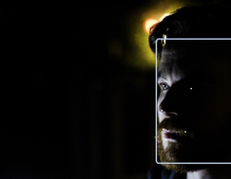

Face detection, analysis, and recognition
Pose
Lighting
Blur and occlusion

Slide 27
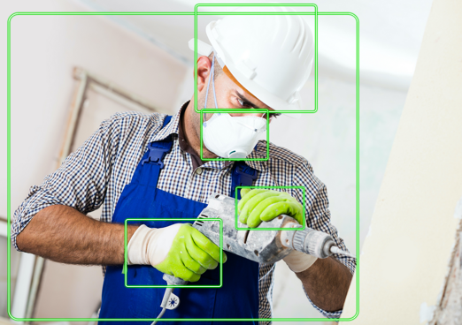
Personal Protective Equipment (PPE) Detection
Analyze images to detect if persons are wearing Face covers, head covers, hand covers
Head Cover 97%
Head Cover on head: true 96%
Face Cover 98.8%
Face cover on face: true 83.5%
Hand Cover 98.8%
Hand Cover on hand: true 94.8%

Slide 28
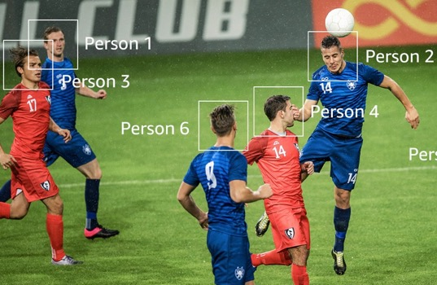
Activities and paths
When analyzing video, you can also identify specific activities such as “playing soccer
You can also capture the path of people or objects in the scene

Slide 29

Amazon Rekognition Custom Labels
What is it?
Automated Machine Learning (AutoML) vision service that enables…
customized image analysis
to easily detect objects and scenes you define as most relevant
to your domain at scale
Notes:
General to specific
Bring your own data
Domain experts can define labels

Slide 30
Amazon Rekognition Custom Labels
How it Works
Step 1:
Guided experience to create labeled images
Core Benefits
No ML expertise required
Low Code / No Code
Less training data
Tens to hundreds of images instead of tens of thousands
Fully managed by AWS
Step 2:
“Train” with a single click / API call. Evaluate with no coding and no ML experience
Step 3:
Use with fully managed, scalable, available APIs
Notes:
The images you train on and preparing your dataset is one of the most important parts of creating any custom model
You can bring already labeled data and through a console or APIs upload
OR you can bring images and have a guided experience to label those images.
No ML experience needed, once your images are in – you train. You can do it without code and no ML experience.
Ease of use of Rekognition

Slide 31




Examples of Custom Labels in Amazon Rekognition
Products
Icons, logos, and symbols
Comic and animation
Biological
Notes:
Making the service be responsive to our customer needs means enabling the service to understand things like:
Machine parts and being able to identify that this is a Turbocharger.
Recognizing logo, icons, and symbols that are important, the in example it would be the AWS architecture icons like EC2, S3, Amazon Rekognition, and Kinesis.
Comic or animated graphics like Arthur and Buster
Identifying bio diversity and its condition. In this case a healthy versus infected cucumber leaf.
Customers are using this for:
Custom Logos, Brands and Icons
Find animated characters
Identify specific objects, products or parts
Classify content at the image level identifying scenes etc.

Slide 32


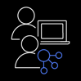

How we can help
Solution Architects
ML Solutions Lab
Engage with a solution architect dedicated to your account
Brainstorm use cases and get support for solution implementation
Identify key areas where machine learning could help you with an AWS AI expert
Let AWS experts build POCs and custom solutions for your use case
Immersion day, workshops, training, and certification
AWS Partner Network
Let AWS certified partners help you with the POC and build integrations with your current systems to productionize
Conduct training workshops and hackathons for builders in your organization
Practical education on ML for new and experienced practitioners
Based on the same material used to train Amazon developers
Notes:
We recommend that you start a POC to test out the accuracy benefits that your business can see. AWS experts, Solution Architects and Partners can help you with a POC.

Slide 33
Q & A

Slide 34
Thank you!

